Slide 1
Unit 3A
Human Diversity & Change
Variation & evolution
Exploring the past

Slide 2

Study Guide
Read:
Chapter 16 Human Perspectives 7th Edition

Slide 3
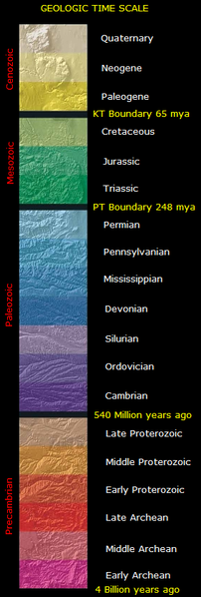
The geological time scale
The geological time scale is a model used by geologist in which the geological history of the earth is divided into units (eons, eras, periods and epochs).

Slide 4
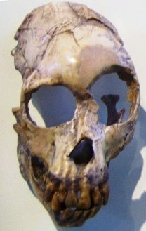
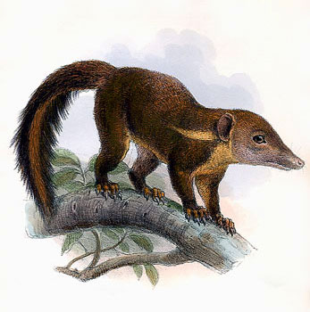
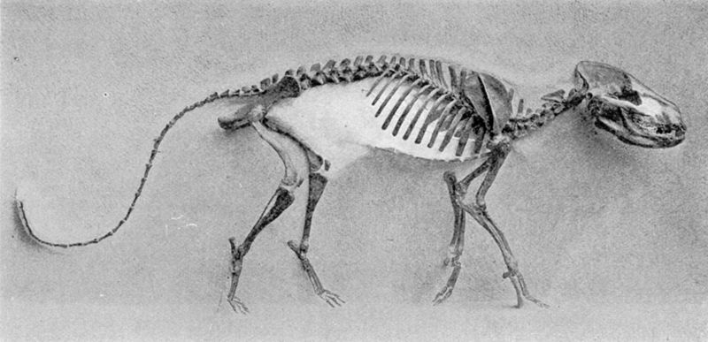
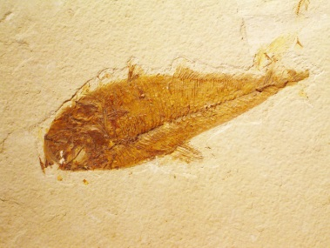
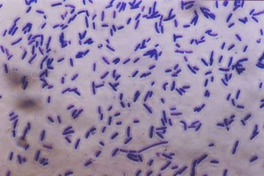
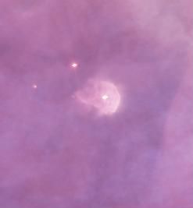
First hominids
5 million yr?
First primates
65 million yr
First mammals
200 million yr
First vertebrates
450 million yr
Appearance of life
3.5 billion yr
Origin of the earth
4.5 billion yr

Slide 5
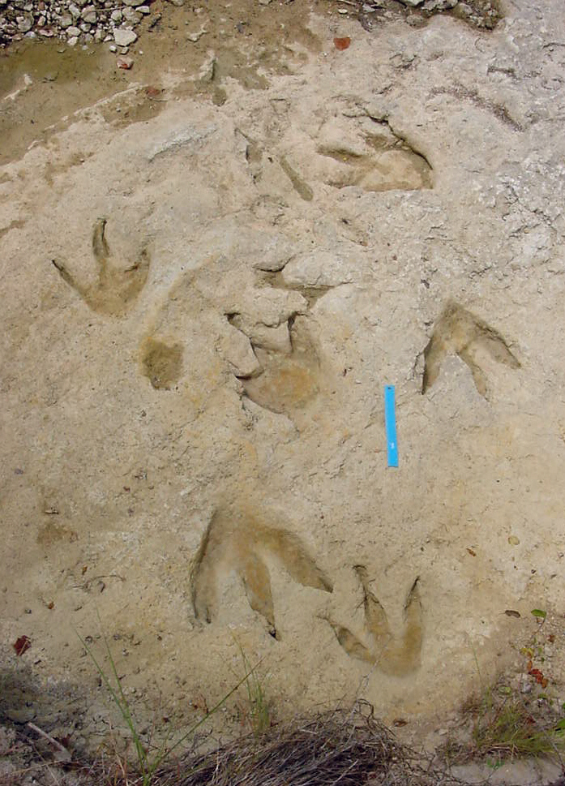
Fossils and fossilisation
Fossil dinosaur footprints
Glen J Kuban
Fossils are the preserved remains, or traces, of once-living organisms.

Slide 6
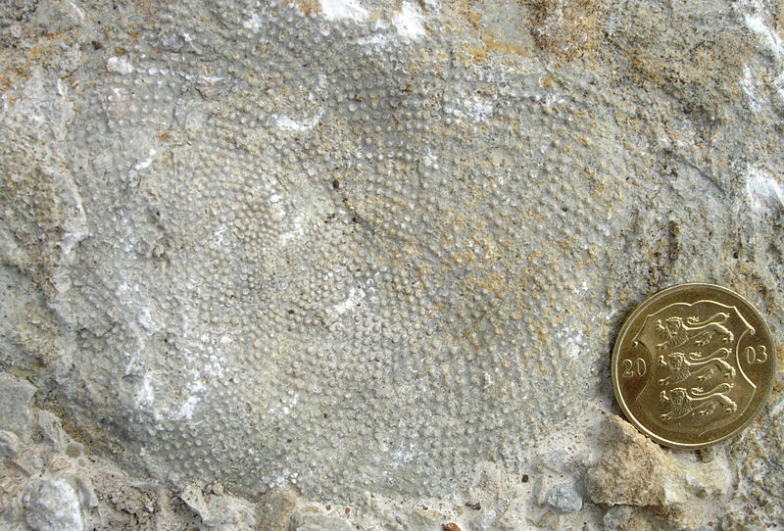
So – you want to be a fossil?
( a D.I.Y. guide to fossilisation)
Sometimes soft tissues, such as the algae shown above, are preserved; however, it is much more common for hard tissues, such as bone or shell, to be fossilised.

Slide 7
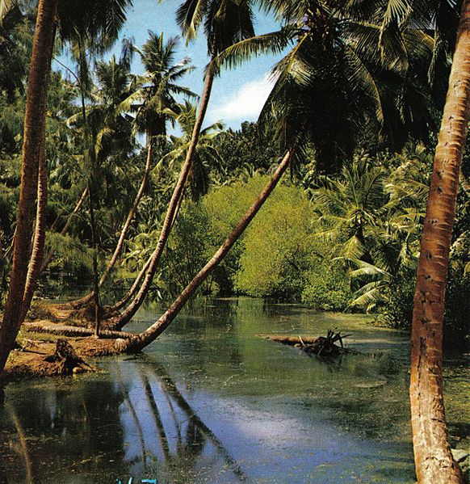
Die in water, not on land. Your remains are more likely to be buried by sediment and less likely to be destroyed by scavengers or erosion.
Choose a low energy environment (a lake or swamp). Your remains are less likely to be destroyed by mechanical processes.

Slide 8
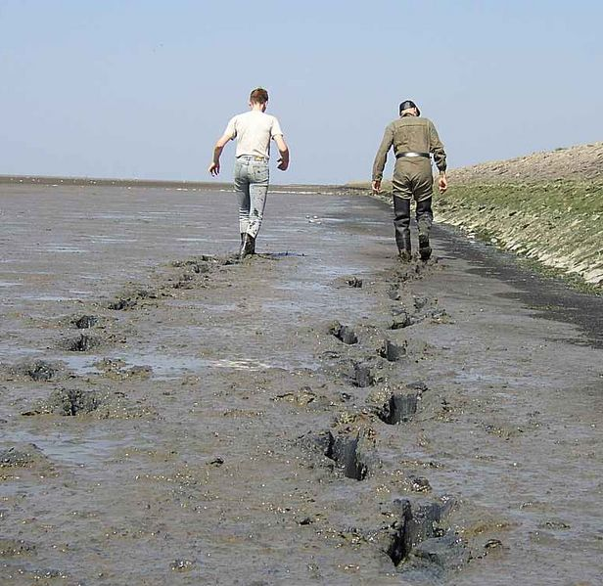
The finer the sediment (e.g. mud) the better. This excludes oxygen and slows bacterial decay, enabling soft tissues to be preserved.

Slide 9
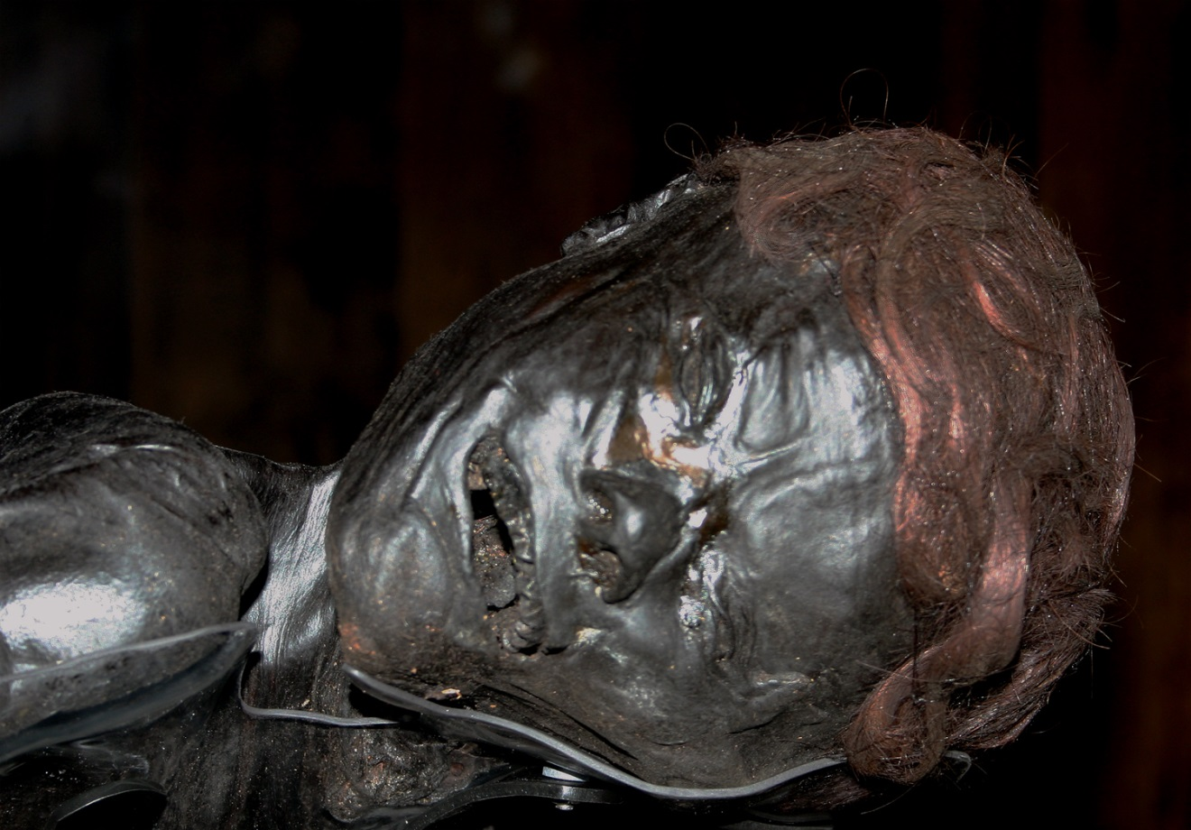
Grauballe man -
a Danish Iron Age bog burial
Malene Thyssen
Rapid burial by sediments protects your remains from scavengers and mechanical damage.
An alkaline environment favours the preservation of hard parts. An acid environment favours the preservation of soft parts.
Notes:
In this case the bones are not actually preserved, only the soft tissue, even the stomach contents.

Slide 10
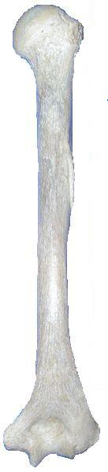
Mineral replacement
There are varying degrees of mineral replacement (0 -100%).
Stage 1 - Minerals from groundwater fill pores in the bone or shell (permineralisation).
Stage 2 – minerals forming the bone matrix, or shell, are dissolved away and replaced by minerals in the groundwater.
Minerals dissolved from bone matrix
Minerals deposited from groundwater

Slide 11
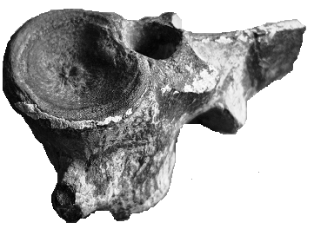
Mineral replacement
206 million year old Ichthyosaur
vertebrae from the Jurassic

Slide 12
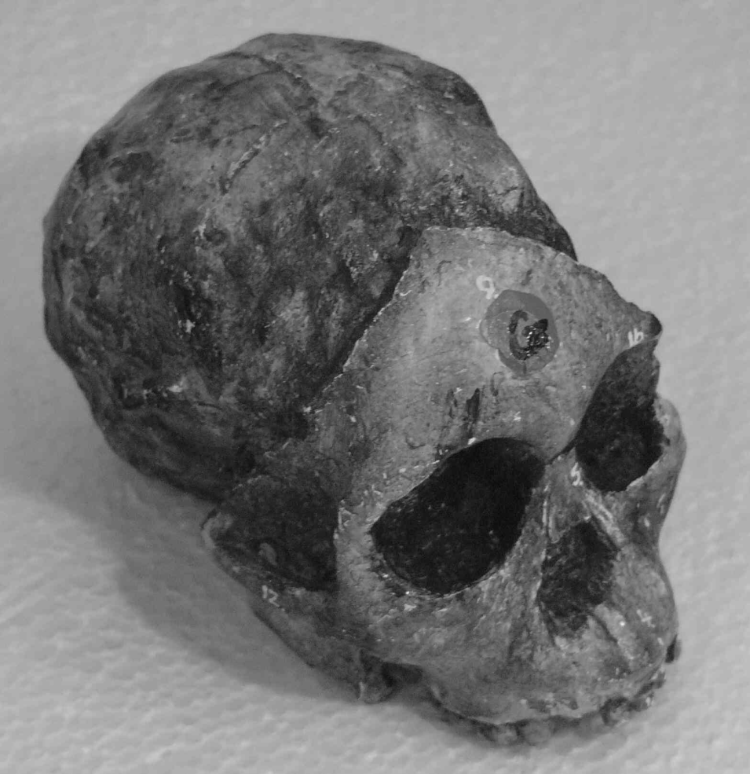
The Taung child
Fossils formed by mineral replacement provide a three-dimensional replica of the original material.
In the fossil opposite, the facial bones (formed by mineral replacement) have broken away to reveal an endocast of the brain -
(an endocast is a cast fossil formed when an empty cavity, such as the cranium, is filled with mud).

Slide 13
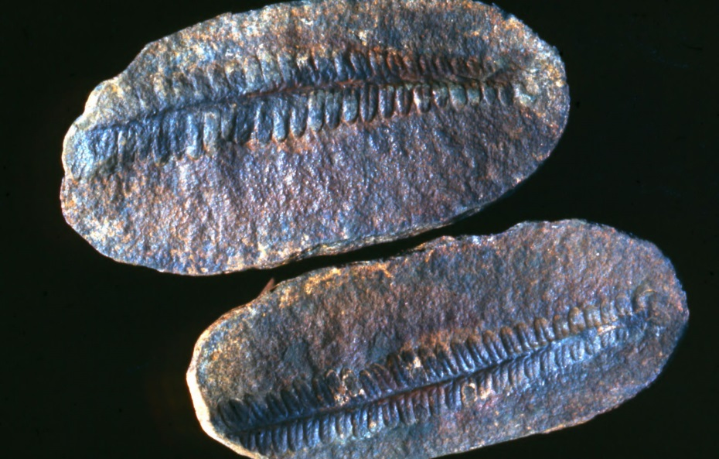
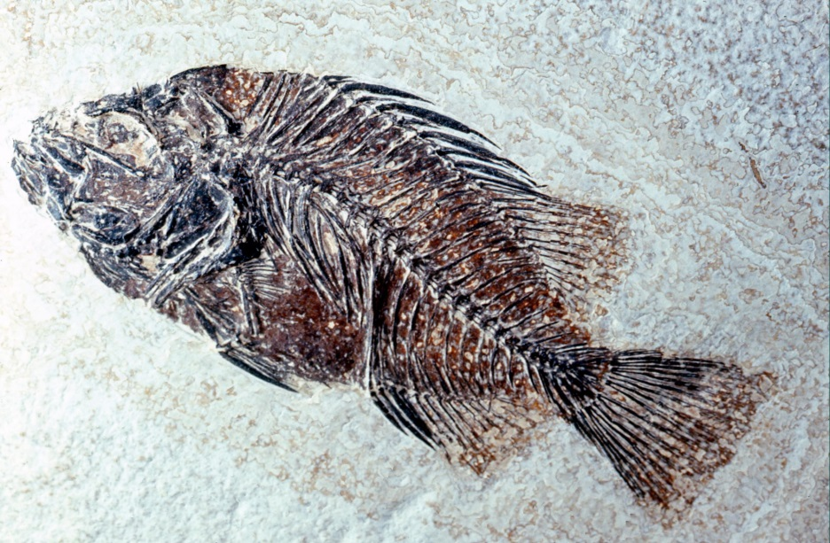
Carbonisation
Carbonised fossils provide a two-dimensional carbon impression of an organism.
Carbonisation usually occurs in very fine-grained rocks and can preserve both soft and hard tissues.
Carbonisation often occurs hand-in-hand with mineral replacement (e.g. the fish fossil).
Dave Dyet

Slide 14

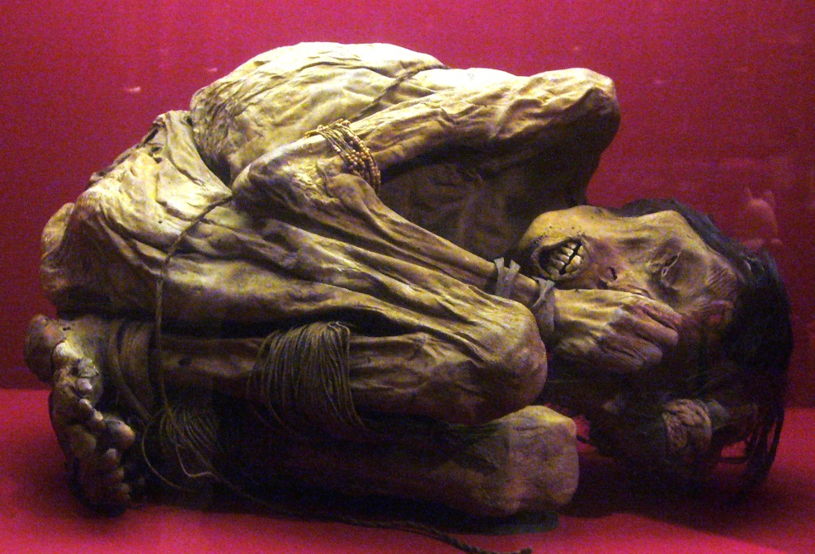
Mummification
Mummification occurs when soft and/or hard tissues are exposed to chemicals, extreme cold, very low humidity, or lack of air (e.g. when bodies are sealed in fine sediment, resin or tar).
A
Malene Thyssen
B
A – Bog burial, Denmark; B – Mummy, South America

Slide 15
Relative dating
Relative dating compares the age of one thing with that of something else
e.g. A is older than B.
Examples include:
  Superposition (for a single outcrop)
  Comparative stratigraphy (for 2 or more
  outcrops)
  Index fossils (for 2 or more outcrops)
  Fluoride dating

Slide 16
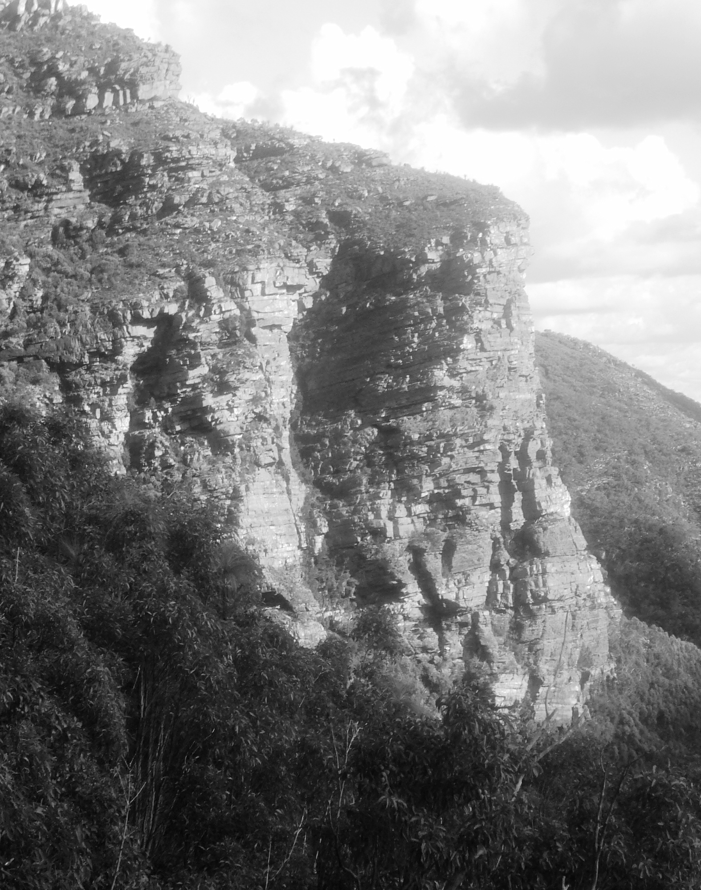
Superposition
Youngest
Youngest bed
Oldest bed
Oldest
Unless disturbed, the lower beds in a sedimentary sequence are older than the rocks above.

Slide 17
Comparative stratigraphy
Location B
Location A
Matching
beds
Stratigraphy is the study of sedimentary rocks.
If the sequence of sedimentary rocks in different areas is similar it is likely that they are of the same age.

Slide 18
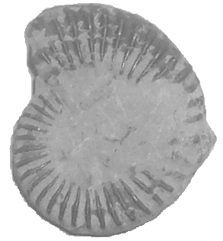
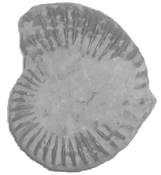
Index fossils
Index
fossils
An index fossil is a fossil of a species that can be used for relative dating.
Index fossils are of distinctive appearance, have a short time span and have a broad geographical distribution.
If rocks in different locations contain the same index fossils, it is likely that both areas are of the same age.

Slide 19
Fluorine dating
F
F
Bones buried in the same environment absorb fluorine at the same rate.
If bones found at the same location contain the same concentration of fluorine, it can be assumed that they are of the same age.

Slide 20
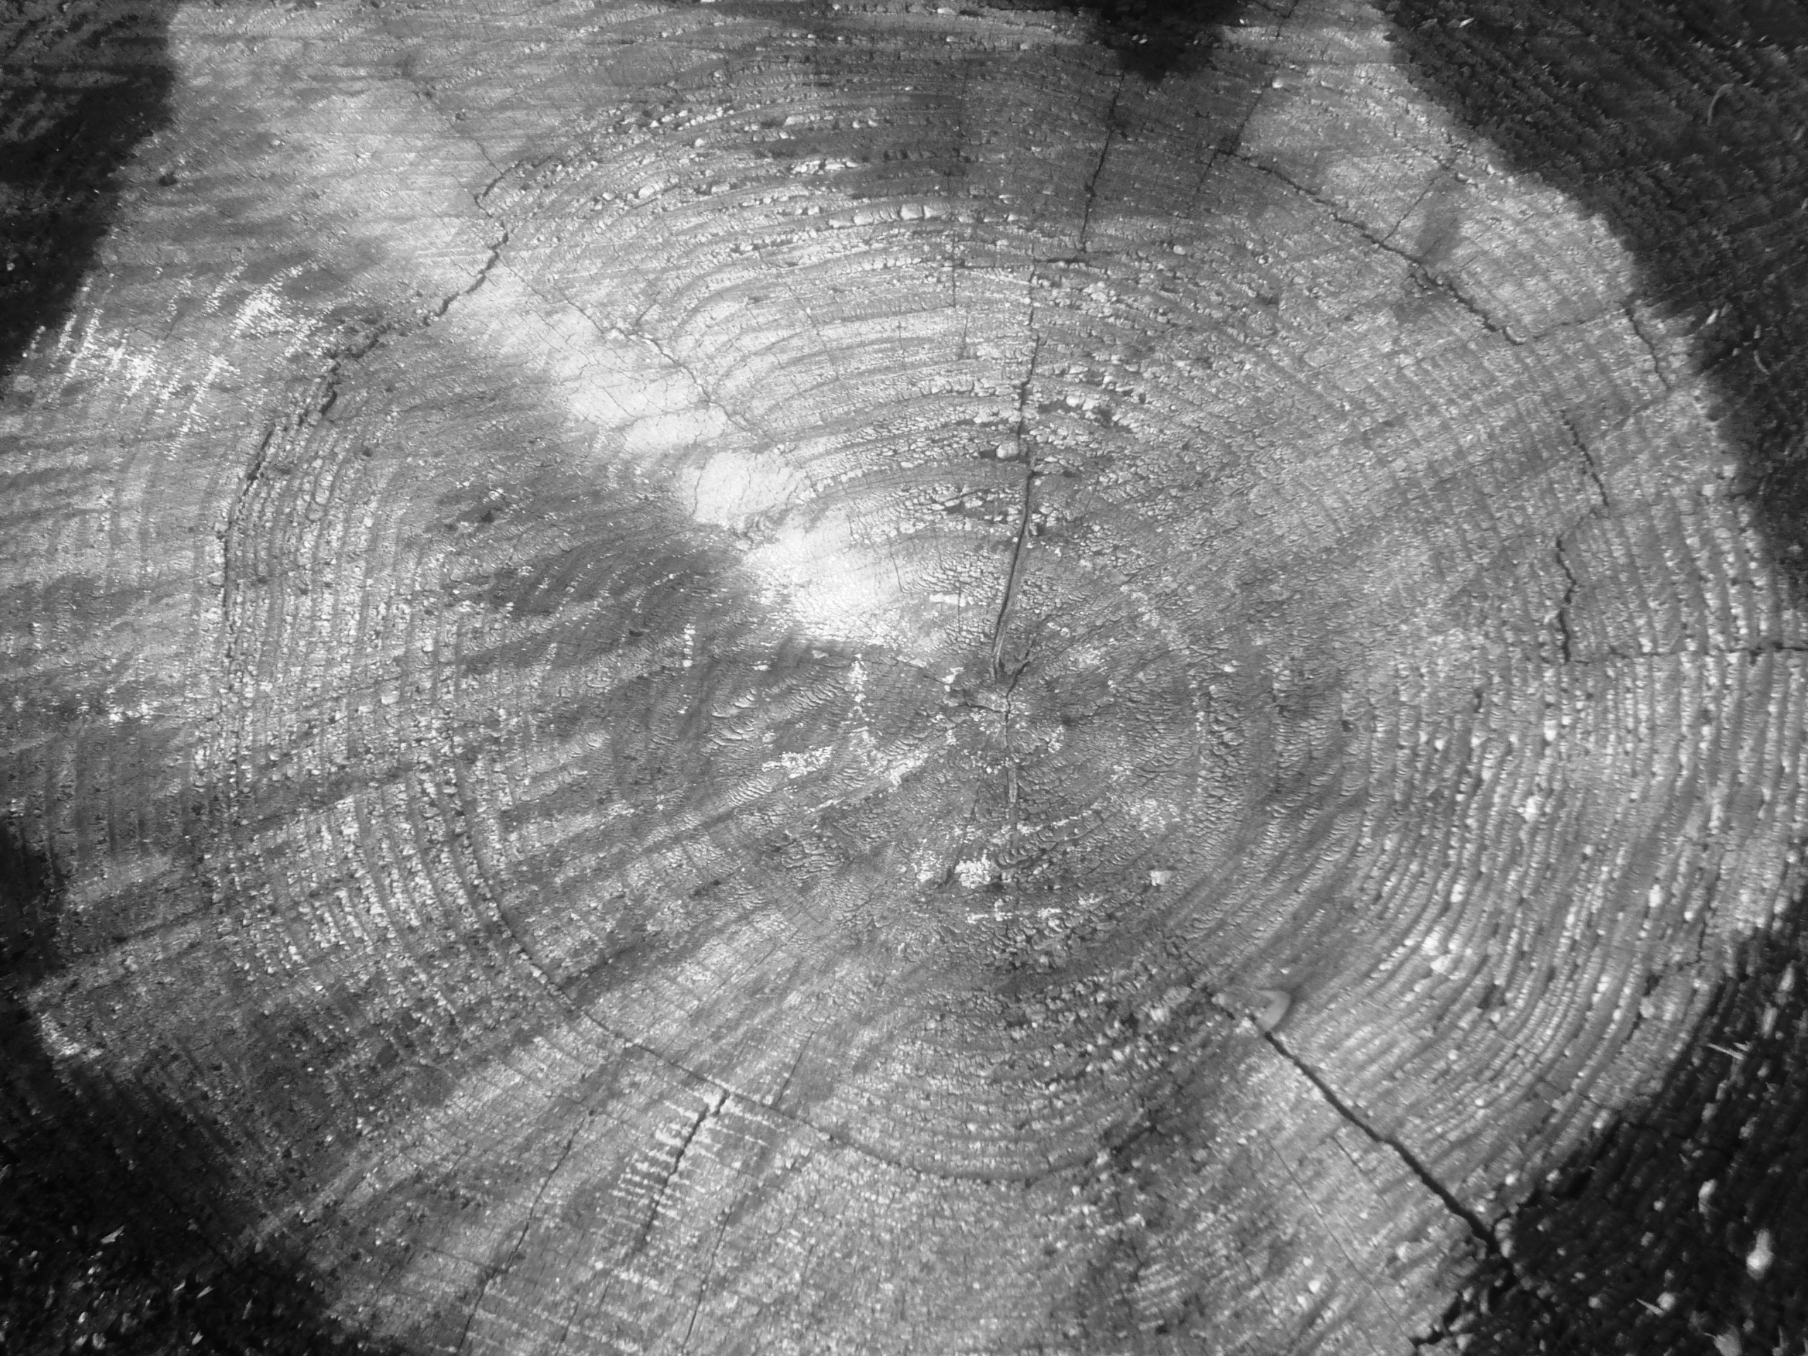
Absolute dating
Absolute dating tells you the chronological age of an object (e.g. 500 yr).
Absolute, or chronological dating, is based on any event which occurs at a constant rate or is repeated at regular intervals and is measurable.
e.g. Tree ring dating
  Sedimentation
  Palaeomagnetism
  Fission tracks
  Radiometric/radioisotope
  Luminescence
Each concentric ring represents one year’s growth

Slide 21
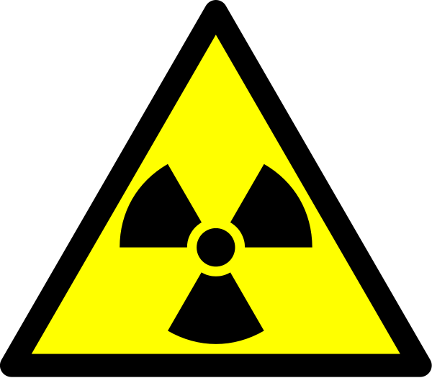
Radiometric/radioisotope dating

Slide 22
Radiometric dating
Radiometric (also known as radioisotope or radioactive) dating is an absolute dating method for determining the chronological age of a rock or mineral by measuring the proportions of an original radioactive material and its decay product.

Slide 23
Radioisotope
Some elements have more than one atomic form (same atomic number but with different numbers of neutrons) – these are referred to as isotopes.
Radioisotopes are unstable and break down or decay to form more stable isotopes of another element (the daughter product). Radioisotopes are radioactive, emitting radiation as they undergo decay, which can be measured.
e.g. Carbon-14 Nitrogen-14

Slide 24
Half life
Half lives
2
Original mass of radioisotope
1
4
3
Residual radioisotope
Each isotope has a unique rate of decay described as its half life (i.e. the time taken for half of any given amount of the isotope to decay).
e.g. Carbon-14 5 730 yr (half life) Nitrogen-14

Slide 25
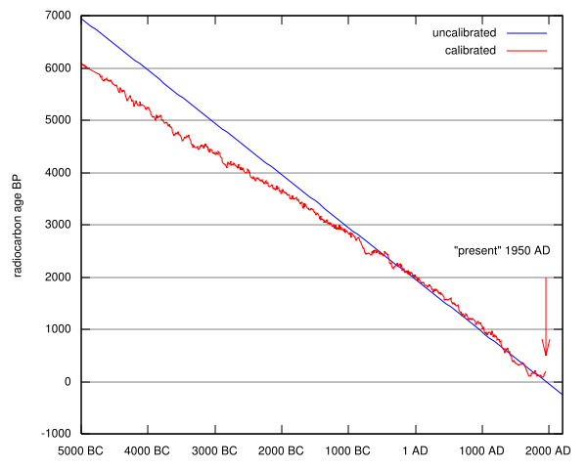
Half life decay curve for carbon fourteen

Slide 26
Radioisotopes commonly used for radiometric dating
Carbon-14 (5730 years)→ Nitrogen-14
Potassium-40 (1.3 billion years)→ Argon-40
Rubidium-86 (18.66 days) → Strontium
Uranium-238 (4.5 billion years) → Lead
Notes:
Carbon -14 and Potassium-40 are the ones that we need to know.

Slide 27
Luminescence
Luminescence is a fairly recent technique used for dating artifacts such as stone tools and pottery.
When crystals of thorium and potassium in the soil are irradiated, part of the radiation is released in the form of light and the rest is trapped in the crystal lattice of the material to be dated (e.g. pottery or stone).
When the material is heated, the stored energy is released as light, the so called thermoluminescence effect.
Thermoluminescence dating can be used to determine how much time has elapsed since the last time the object was heated. The older the object, the more light will be released.
Notes:
Again, this is more of interest.

